Slide 1
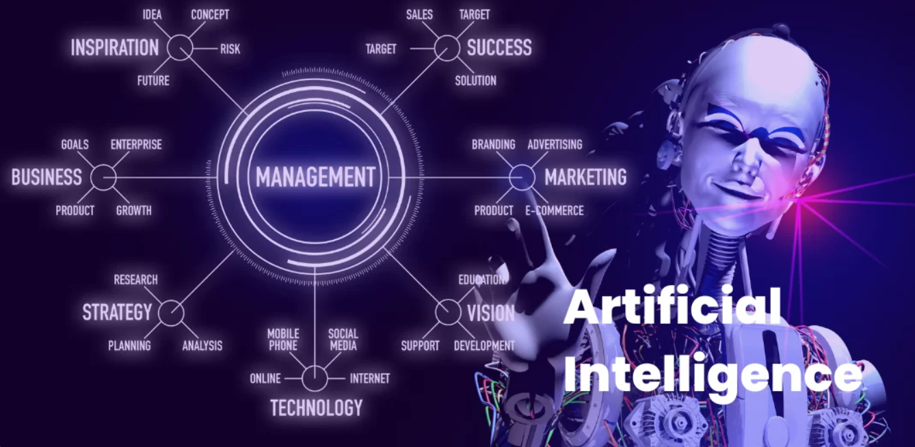
DSA 2020
Edward Ombui, PhD

Slide 2
COURSE DETAILS
UNIT TITLE: INTRODUCTION TO ARTIFICIAL INTELLIGENCE
UNIT CODE: APT3010
TIME: FR 8:00hrs to 11:200hrs
PERIOD: 14 weeks
VENUE: LAB4
Lecturer: Dr. Edward Ombui

Slide 3
COURSE PURPOSE
This course is designed to develop the learner’s understanding of the theoretical underpinnings and practical applications of Artificial Intelligence.
The course will cover knowledge representation and reasoning processes, explain fundamental concepts in machine learning, neural networks, and deep learning, and instil skills in problem-solving using various kinds of search algorithms.

Slide 4
Expected Learning Outcomes
Upon successful completion of the course, the learner will be able to:
Explain AI concepts, including representation, reasoning, search algorithms, and machine learning fundamentals.
Demonstrate proficiency in applying AI techniques to develop AI solutions and critically evaluate their performance
Identify and address ethical issues & biases related to AI technologies' impact on society

Slide 5
Course Resources
ERTEL, WOLFGANG. (2017). Introduction to Artificial Intelligence (2nd ed). Switzerland: Springer Gabler.
Artificial Intelligence: A Modern Approach, 4th edition, Published by Pearson (April 28, 2020) © 2021, Stuart Russell University of California at BerkeleyPeter Norvig
Thomas Erl, Wajid Khattak & Paul Buhler, (2015) Big Data Fundamentals: Concepts, Drivers & Techniques. USA; Prentice Hall

Slide 6
Course Assessment
Assessment type | % score
Attendance and Participation | 10
Laboratory Assignments | 25
Term project/presentations | 15
Mid-Semester Exam | 20
End-Semester Exam | 30
Total | 100

Slide 7
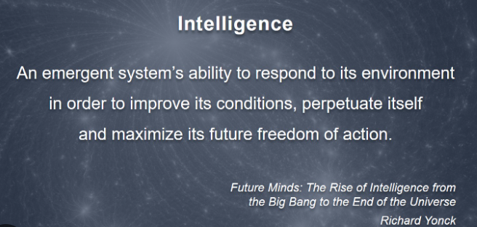
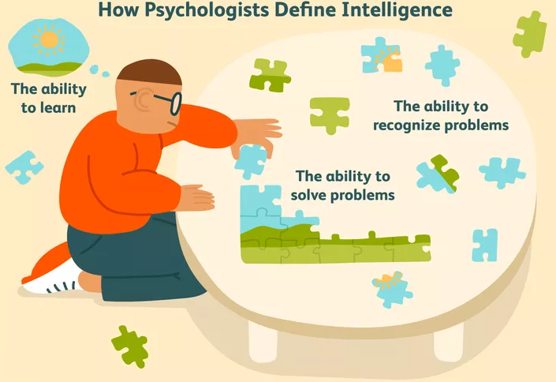
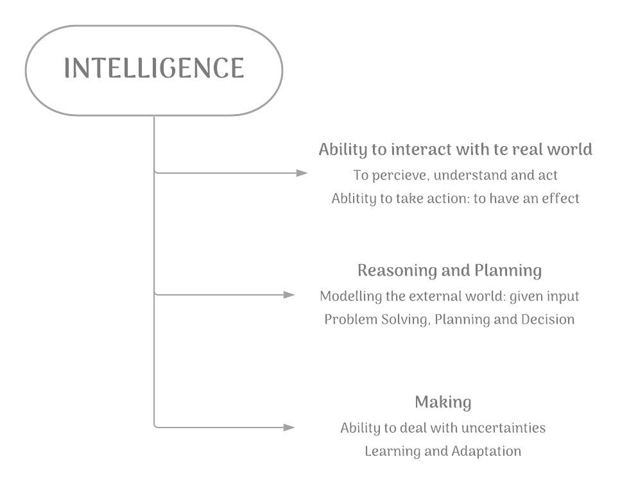
What is Intelligence?
Notes:
The ability to acquire and apply knowledge and skills. (Oxford Dict)
The collection of information of military or political value. (Oxford Dict)
The capacity for learning, reasoning, understanding, and similar forms of mental activity

Slide 8
From psychological point of view:
From a AI/CS point of view:
From a psychological point of view:
1. "Intelligence is not a single, unitary ability, but rather a composite of several functions. The term denotes that combination of abilities required for survival and advancement within a particular culture." A. Anastasi [7]
2. "It seems to us that in intelligence there is a fundamental faculty. the alteration or the lack of which, is of the utmost importance for practical life. This faculty is judgement, otherwise called good sense, practical sense, initiative, the faculty of adapting one self to circumstances." A. Binet [7]
3. "We shall use the term "intelligence' to mean the ability of an organism to solve new problems "W. V. Bingham [7]
4. "A global concept that involves an individual's ability to act purposefully, think rationally, and deal effectively with the environment." D. Wechsler [7]
1. "Intelligence is the ability to use optimally limited resources including time to achieve goals." R. Kurzweil [7]
2. "Intelligence measures an agent's ability to achieve goals in a wide range of environments." S. Legg and M. Hutter [7]
3. "Intelligence is the computational part of the ability to achieve goals in the world. Varying kinds and degrees of intelligence occur in people, many animals and some machines." J. McCarthy [7]
4. "... in any real situation behavior appropriate to the ends of the system and adaptive to the demands of the environment can occur, within some limits of speed and complexity." A. Newell and H. A. Simon [7]

Slide 9
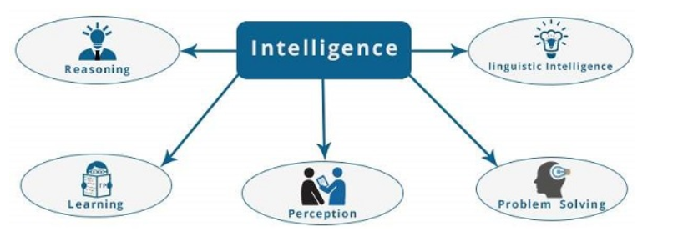
What is Intelligence?

Slide 10
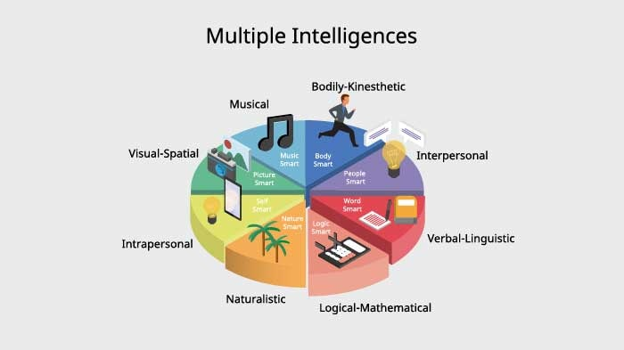
VIDEO

Slide 11
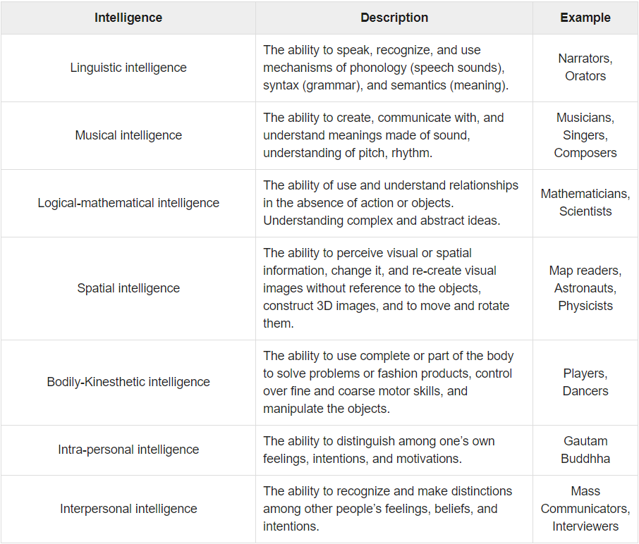

Slide 12
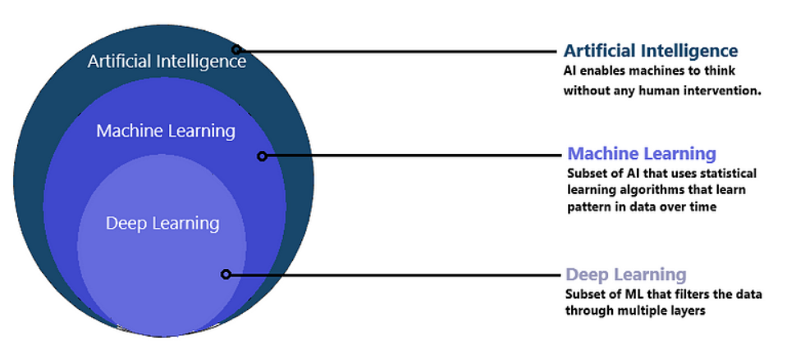

Slide 13
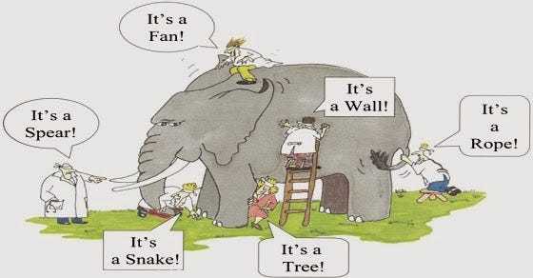

Slide 14
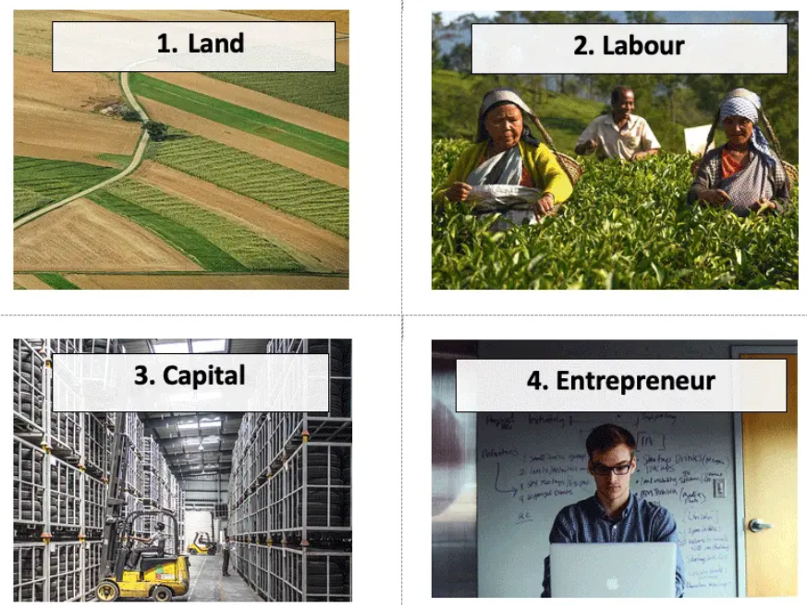
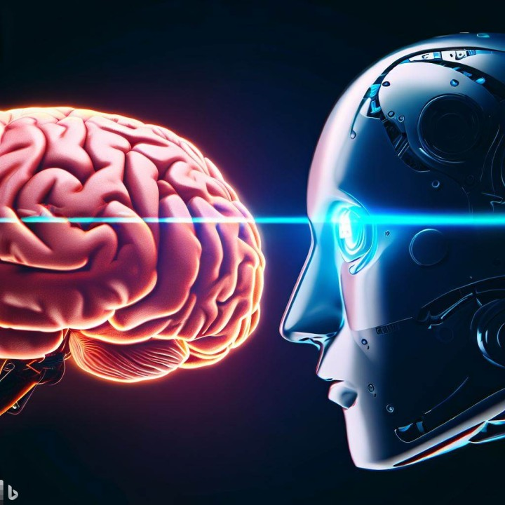
What is Artificial Intelligence?
AI: is the simulation of human intelligence in machines that are programmed to think and act like humans
Notes:
Artificial intelligence (AI) is the simulation of human intelligence in machines that are programmed to think and act like humans. Learning, reasoning, problem-solving, perception, and language comprehension are all examples of cognitive abilities.
Experts regard artificial intelligence as a factor of production, which has the potential to introduce new sources of growth and change the way work is done across industries.

Slide 15
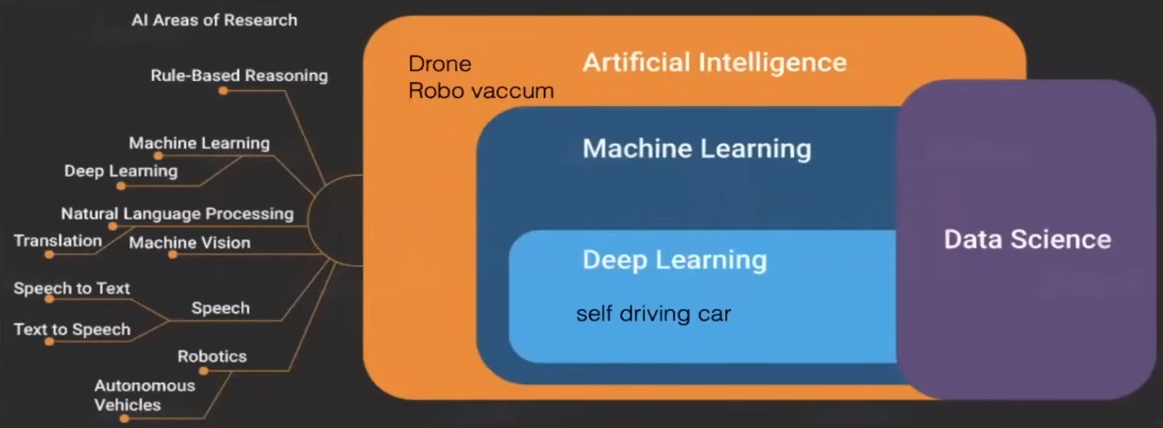
Generative AI
Notes:
In Artificial Intelligence, there are mainly three steps involved: learning, reasoning, and self-correction

Slide 16
What is Artificial Intelligence?
An area of study concerned with making computers copy intelligent human behavior . (Oxford learner’s dictionary)
Artificial : “Made or produced by human beings rather than occurring naturally, especially as a copy of something natural.” (Oxford Dictionary)
The Goal of AI is to develop machines that behave as though they are intelligent
AI was at the onset (1940s) referred to as automation.
NOTE: there’s no AI without DATA
Notes:
The theory and development of computer systems able to perform tasks normally requiring human intelligence, such as visual perception, speech recognition, decision-making, and translation between languages. (Oxford Reference)

Slide 17
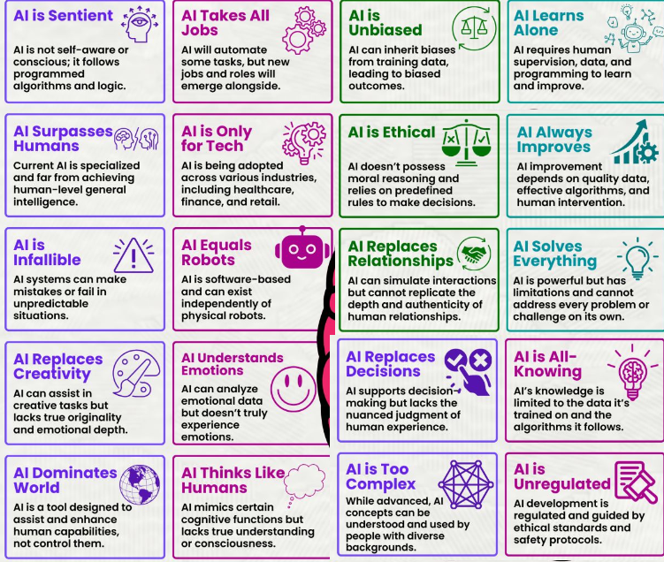
AI Myths

Slide 18

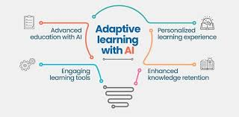



Slide 19



Fruitchitecture Designing within hours with AI

Slide 20


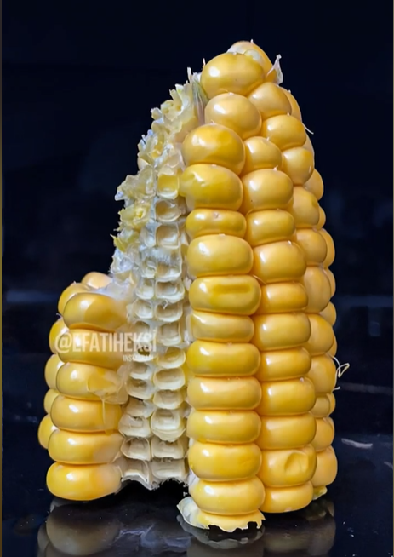

Slide 21




Slide 22
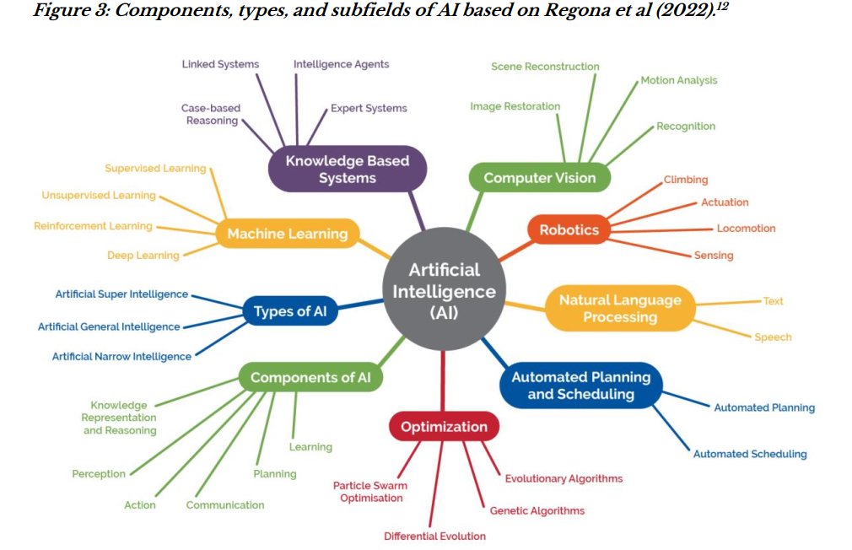

Slide 23
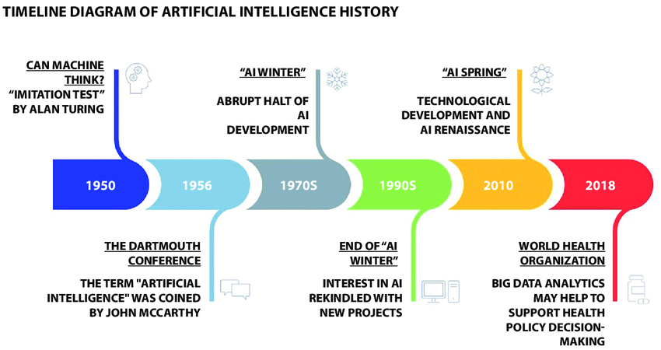

Slide 24
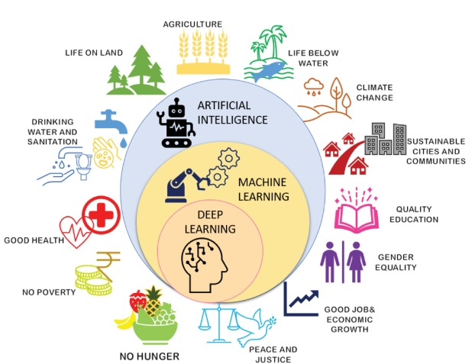

Slide 25
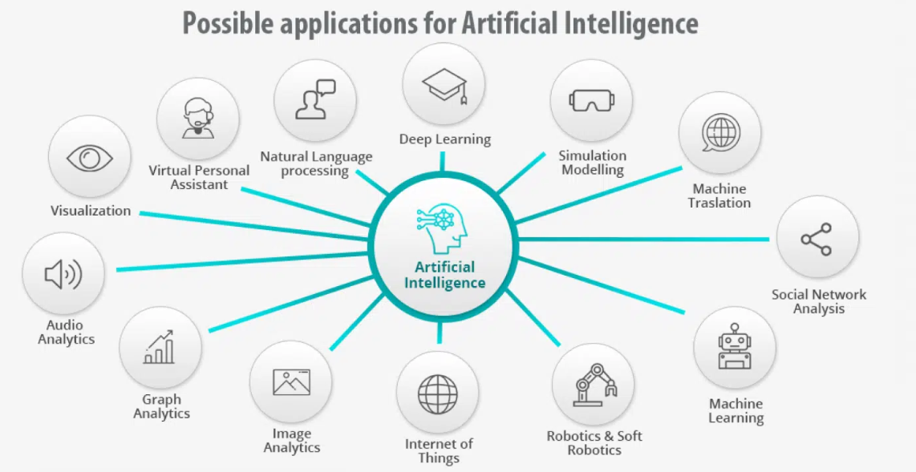
VIDEO

Slide 26
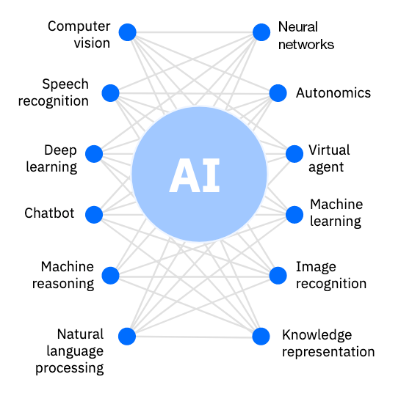
Building Blocks of AI
AI is not one technology but a set of technologies and building blocks including NLP, ML, DL, NN, VA, Autonomics, CV

Slide 27
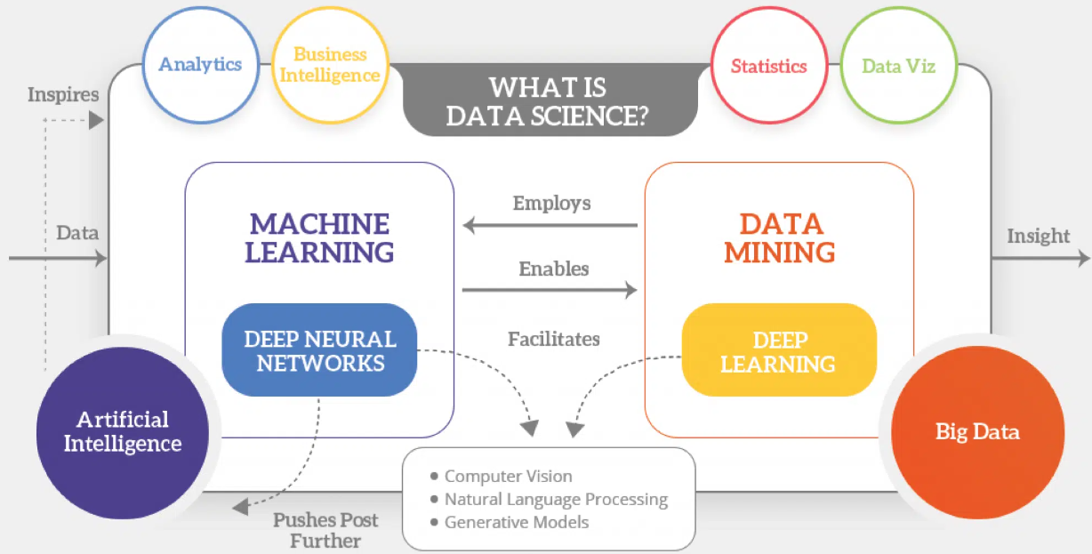

Slide 28
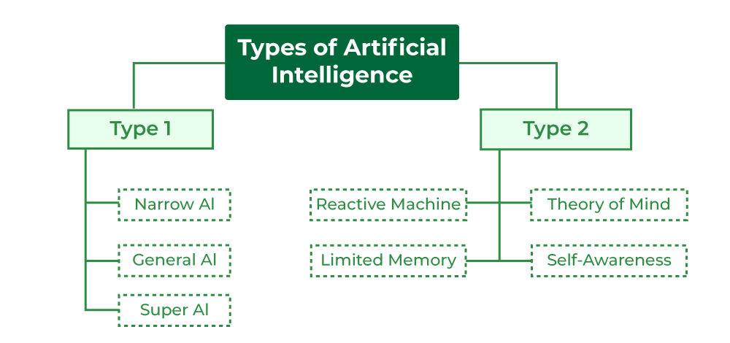

Slide 29
Group Assignment
Groups: Application of AI in
Health
Education
Security
Marketing
Finance
Agriculture
Entertainment
Notes:
Narrow AI: Narrow AI also known as Weak AI or Narrow AI. Narrow AI is designed and trained ona specific task or a narrow range tasks. These Narrow AI systems are designed and trained for a purpose. These Narrow systems performs their designated tasks but mainly lack in the ability to generalize tasks. Personal Virtual assistance like Alexa or Siri, recommendation systems, image recognization software and other language translation tools.
General AI: It is known as Strong AI. It refers to AI systems that have human intelligence and abilities to perform various tasks. Systems have capability to understand, learn and apply across a wide range of tasks taht are similar to how a human can adapt to various tasks. In general AI remains a theoretical concept, and now no AI can achieve this level of intelligence.
Super AI: It is known as Superintelligent AI that surpasses intelligence of human in solving-probem, creativity, and overall abilities. Super AI develops emotions, desires, need and beliefs of their own. They are able to make decisions of their own and solve problem of its own.

Slide 30
Delivering Business Value with AI
AI has the potential to disrupt and replace current business architectures and enterprise software
AI does not directly provide the business outcome, but an enabler to help enterprises achieve their goals effectively, productively, and intelligently
E.g. digital organization can work in real-time to cater to its clients, rapidly support their needs, and help anticipate changes to the business environment to stay ahead of the market.

Slide 31
Videos to Watch
Top 10 Applications Of Artificial Intelligence in 2021 - YouTube
What Actually Is Human Brain | AH Documentary - YouTube

